Slide 1


Demo Salesforce Progress
Aslene OUAZE

Slide 2
TABLE OF CONTENTS
01
02
Apex Triggers
Apex Testing
03
Visualforce Basics

Slide 3


01
Apex Triggers

Slide 4
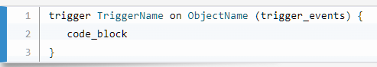
Apex Triggers
Apex triggers enable us to perform custom actions before or after events to records in Salesforce, such as insertions, updates, or deletions.
before insert
before update
before delete
after insert
after update
after delete
after undelete

Slide 5
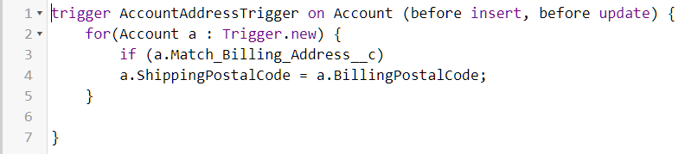
Apex Triggers Using Context Variables
To access the records that caused the trigger to fire, use context variables.
For example, Trigger.new contains all the records that were inserted in insert or update triggers.
Trigger.old provides the old version of sObjects before they were updated in update triggers, or a list of deleted sObjects in delete triggers.

Slide 6
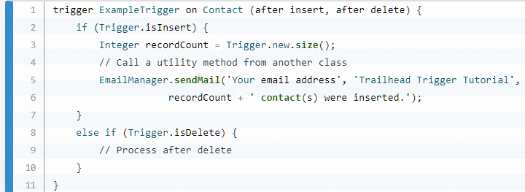
Apex Triggers Calling a Class Method from a Trigger
We can call public utility methods from a trigger.
Calling methods of other classes enables code reuse, reduces the size of the triggers, and improves maintenance of our Apex code.

Slide 7
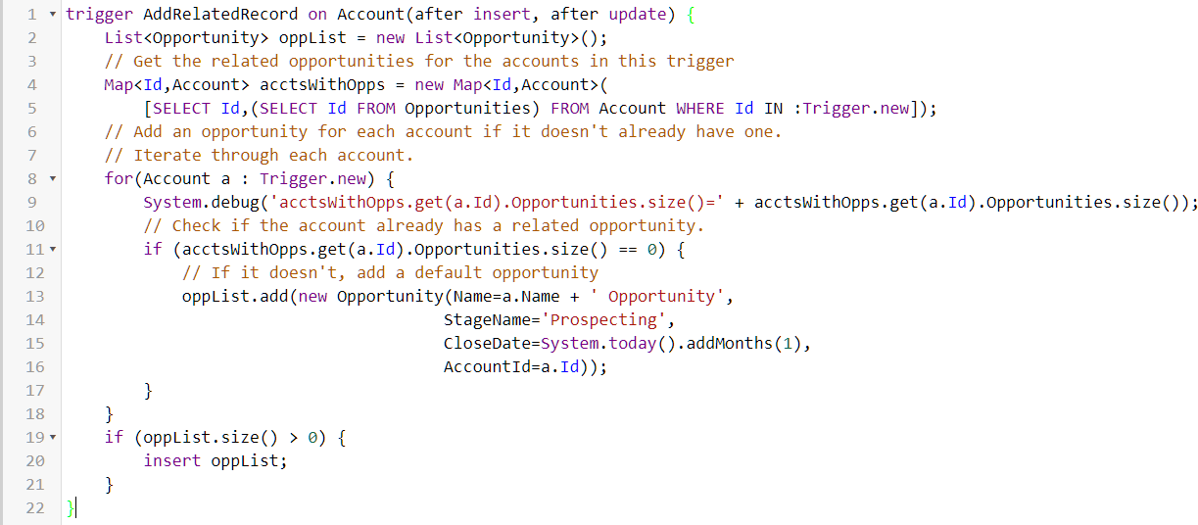
Apex Triggers Adding Related Records
Triggers are often used to access and manage records related to the records in the trigger context—the records that caused this trigger to fire.

Slide 8
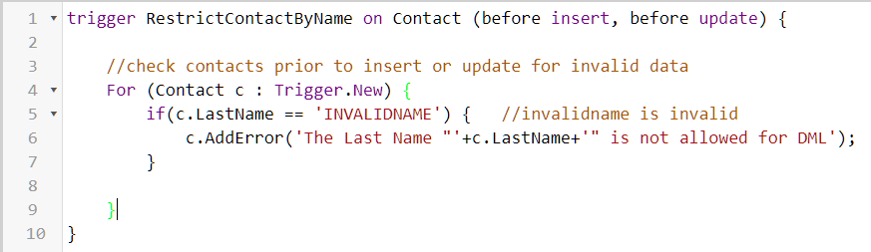
Apex Triggers Exceptions

Slide 9
Apex Triggers Bulk Apex Triggers
Apex triggers are optimized to operate in bulk. We use bulk design patterns for processing records in triggers.
When we use bulk design patterns, your triggers have better performance, consume less server resources, and are less likely to exceed platform limits.
The benefit of bulkifying your code is that bulkified code can process large numbers of records efficiently and run within governor limits on the Lightning Platform.

Slide 10
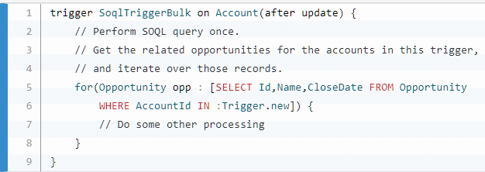
Apex Triggers Performing Bulk SOQL
The SOQL query uses an inner query—(SELECT Id FROM Opportunities)—to get related opportunities of accounts.
The SOQL query is connected to the trigger context records by using the IN clause and binding the Trigger.new variable in the WHERE clause—WHERE Id IN :Trigger.new. This WHERE condition filters the accounts to only those records that fired this trigger.

Slide 11
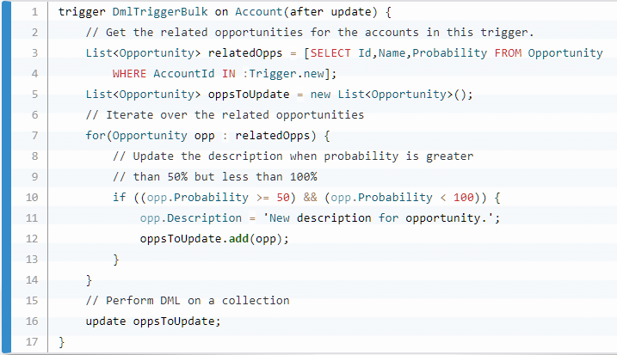
Apex Triggers Performing Bulk DML
When performing DML calls in a trigger or in a class, perform DML calls on a collection of sObjects when possible.
Performing DML on each sObject individually uses resources inefficiently. The Apex runtime allows up to 150 DML calls in one transaction.

Slide 12
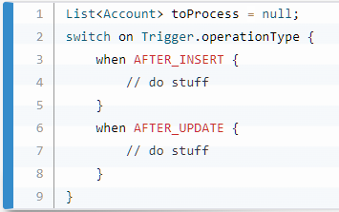
Apex Triggers Bulk Design Pattern

Slide 13

02
Apex Testing

Slide 14
Apex Testing
These are the benefits of Apex unit tests.
Ensuring that your Apex classes and triggers work as expected
Having a suite of regression tests that can be rerun every time classes and triggers are updated to ensure that future updates you make to your app don’t break existing functionality
Meeting the code coverage requirements for deploying Apex to production or distributing Apex to customers via packages
High-quality apps delivered to the production org, which makes production users more productive
High-quality apps delivered to package subscribers, which increase your customers trust

Slide 15
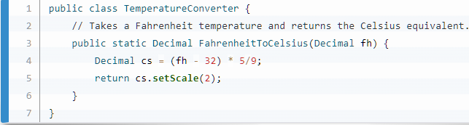
Apex Testing
The following simple example is of a test class with three test methods. The class method that’s being tested takes a temperature in Fahrenheit as an input. It converts this temperature to Celsius and returns the converted result.

Slide 16
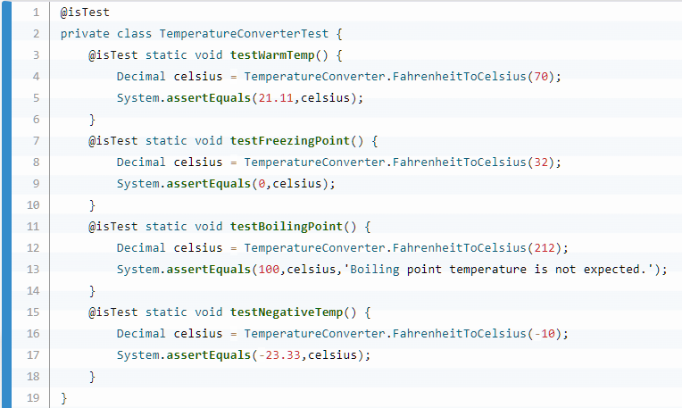
Apex Testing
The TemperatureConverterTest test class verifies that the method works as expected by calling it with different inputs for the temperature in Fahrenheit.
System.assertEquals() method, takes two parameters: the first is the expected value, and the second is the actual value.
The same method can take optional string which is logged if the assertion fails.

Slide 17
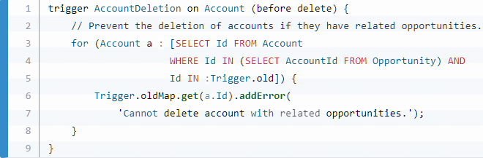
Apex Testing Test Apex Triggers
Before deploying a trigger, write unit tests to perform the actions that fire the trigger and verify expected results.

Slide 18
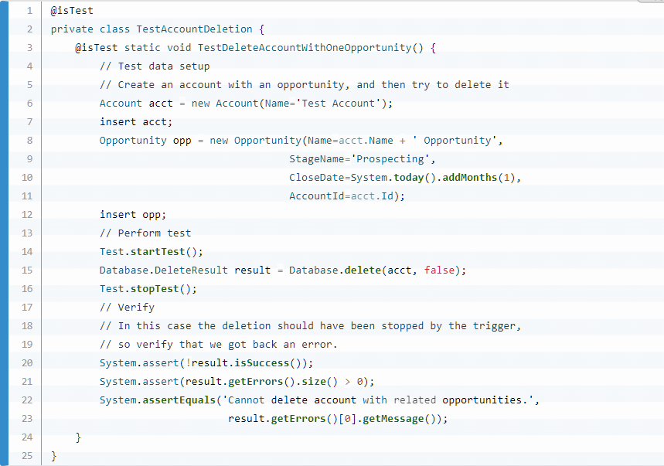
Apex Testing Test Apex Triggers
This test method verifies what the trigger is designed to do (the positive case): preventing an account from being deleted if it has related opportunities.

Slide 19
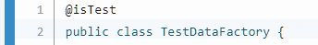
Apex Testing Test Data for Apex Tests
The TestDataFactory class is a special type of class—it is a public class that is annotated with @isTest and can be accessed only from a running test.
Test utility classes contain methods that can be called by test methods to perform useful tasks, such as setting up test data. Test utility classes are excluded from the org’s code size limit.

Slide 20
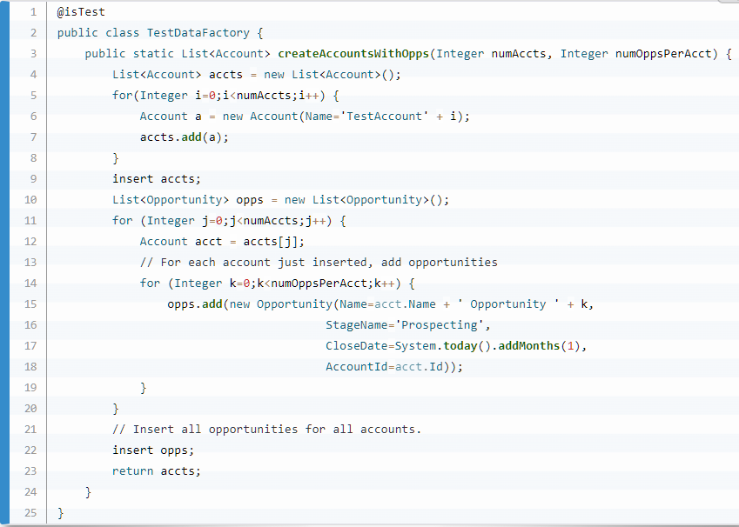
Apex Testing Test Data for Apex Tests

Slide 21
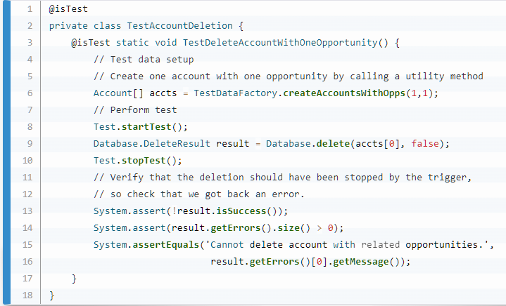
Apex Testing Test Data for Apex Tests
We can use the created test data method in the test class :

Slide 22

03
Visualforce Basics

Slide 23
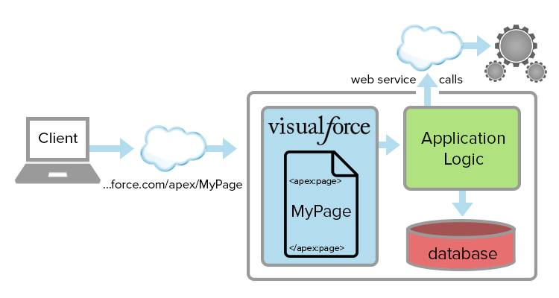
Visualforce Basics
Visualforce is a web development framework that enables developers to build sophisticated, custom user interfaces for mobile and desktop apps that can be hosted on the Lightning Platform.
Visualforce app development is familiar to anyone who has built web apps.
Developers create Visualforce pages by composing components, HTML, and optional styling elements.

Slide 24
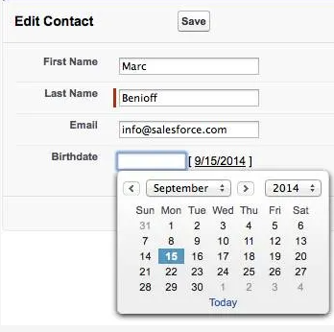
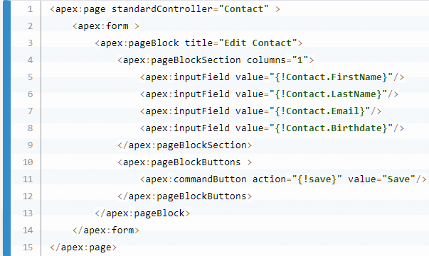
Visualforce Basics

Slide 25
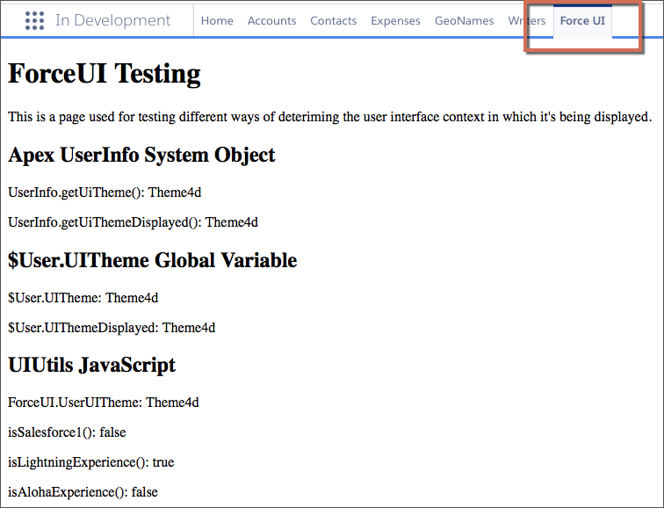
Visualforce Basics
We can add Visualforce tabs to an app and they display as items in the app’s navigation bar.

Slide 26
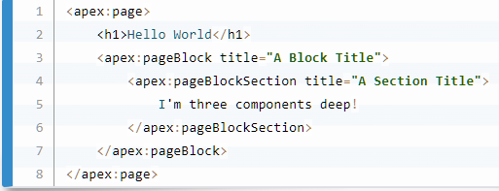
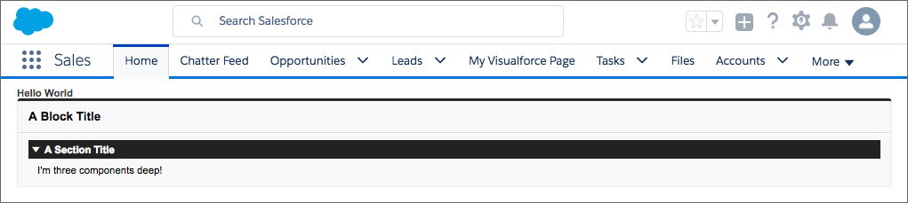
Visualforce Basics Create & Edit Visualforce Pages
We can use the Developer Console to create and edit Visualforce pages, with access to other powerful Lightning Platform development tools.
The Developer Console has automatic syntax highlighting, tag pair matching, auto-suggest and auto-complete,

Slide 27
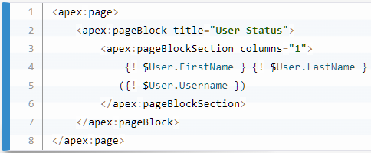
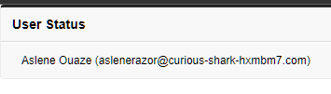
Visualforce Basics Using Simple Variables and Formulas
Use global variables to access and display system values and resources in your Visualforce markup.
For example, Visualforce provides information about the logged-in user in a global variable called $User.

Slide 28
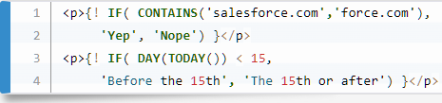
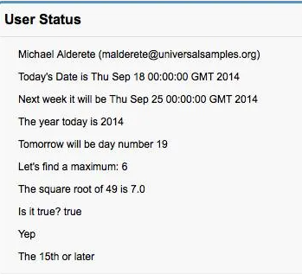
Visualforce Basics Conditional Expressions
Use a conditional expression to display different information based on the value of the expression.

Slide 29
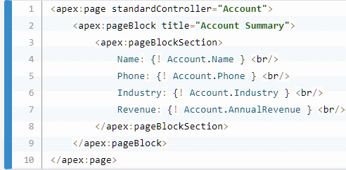
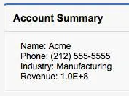
Visualforce Basics Using Standard Controllers
Visualforce uses the traditional model–view–controller (MVC) paradigm, and includes sophisticated built-in controllers to handle standard actions and data access.
Most standard and all custom objects have standard controllers that can be used to interact with the data associated with the object

Slide 30
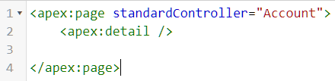
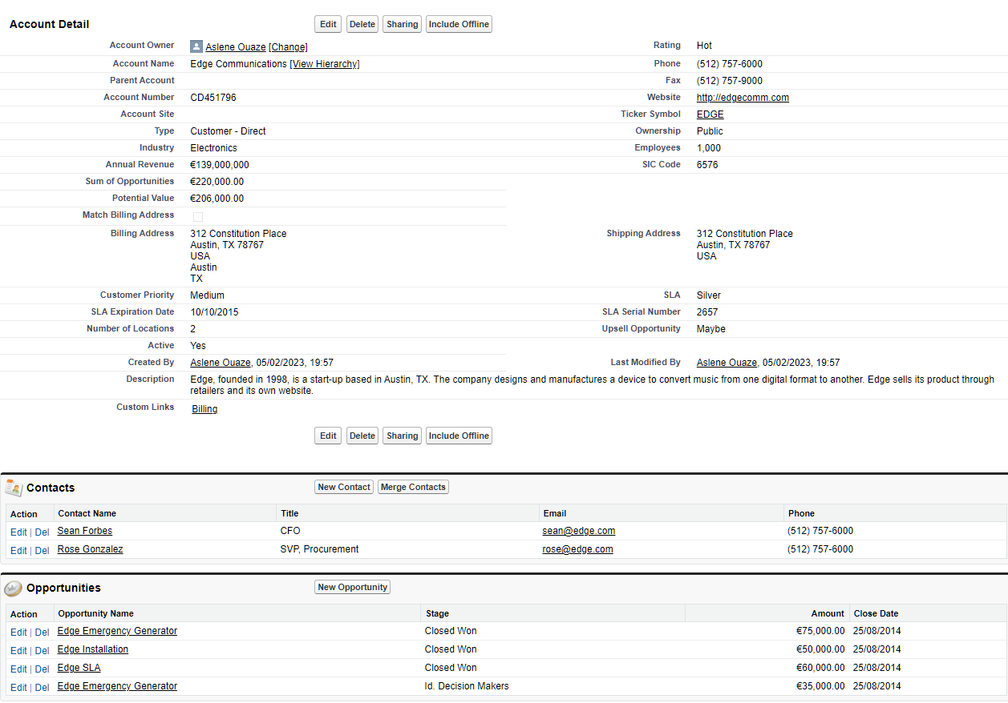
Visualforce Basics Display Record Details
https://curious-shark-hxmbm7-dev-ed--c.trailblaze.vf.force.com/apex/example?core.apexpages.request.devconsole=1&id=0018e000008SCKHAA4

Slide 31
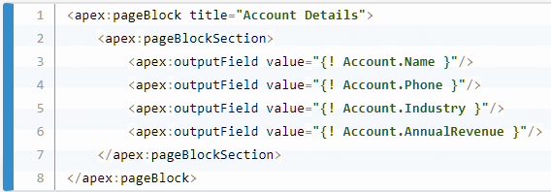
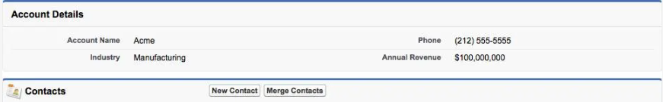
Visualforce Basics Display Individual Fields

Slide 32
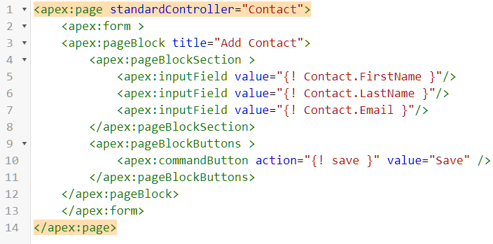
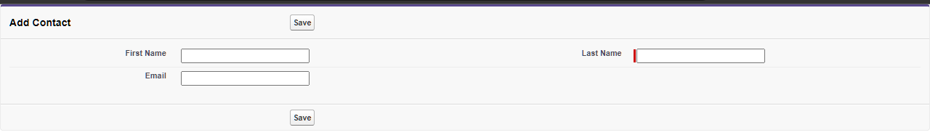
Visualforce Basics Input Data Using Forms

Slide 33
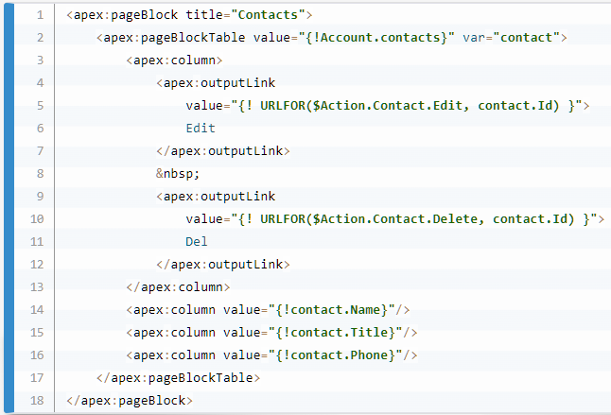
Visualforce Basics Edit Related Records

Slide 34
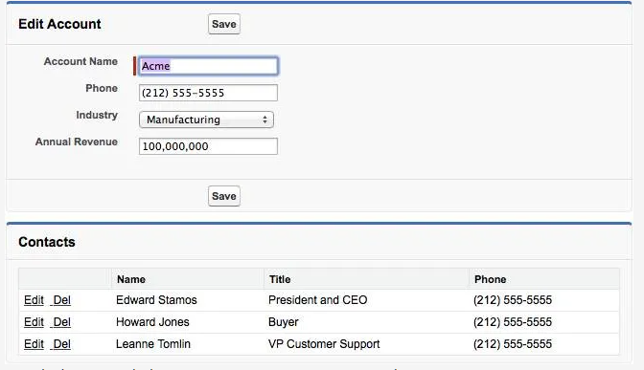
Visualforce Basics Edit Related Records

Slide 35
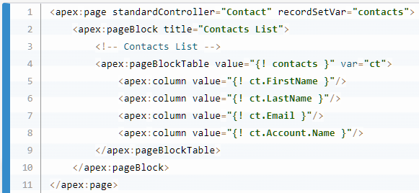
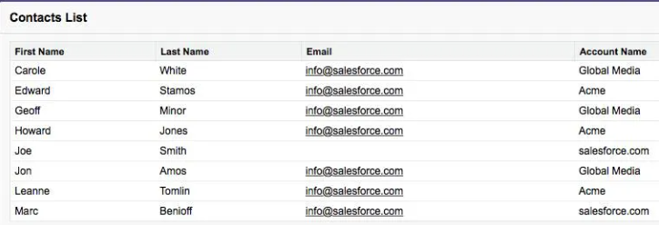
Visualforce Basics Using standard List Controllers
The standard list controller allows you to create Visualforce pages that can display or act on a set of records.
Visualforce makes it extremely easy to display a list of records of the same type, using just markup, no back-end code.

Slide 36
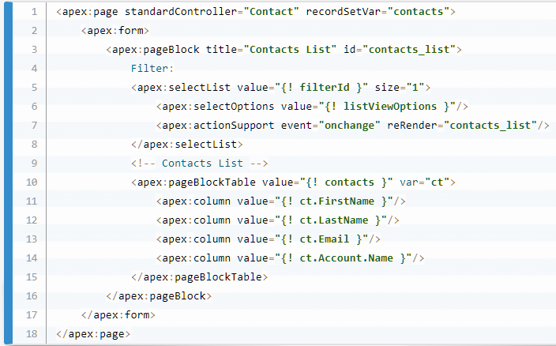
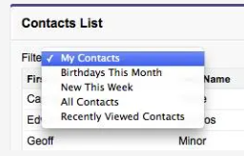
Visualforce Basics Adding List View Filtering to the List

Slide 37
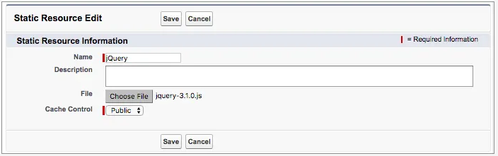
Visualforce Basics Using Static Resources
Static resources allow you to upload content that you can reference in a Visualforce page. Resources can be archives (such as .zip and .jar files), images, stylesheets, JavaScript, and other files.

Slide 38
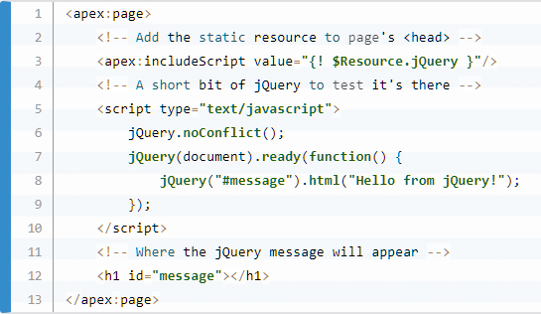
Visualforce Basics Using Static Resources
We can use the $Resource global variable and dot notation to reference a stand-alone static resource.

Slide 39
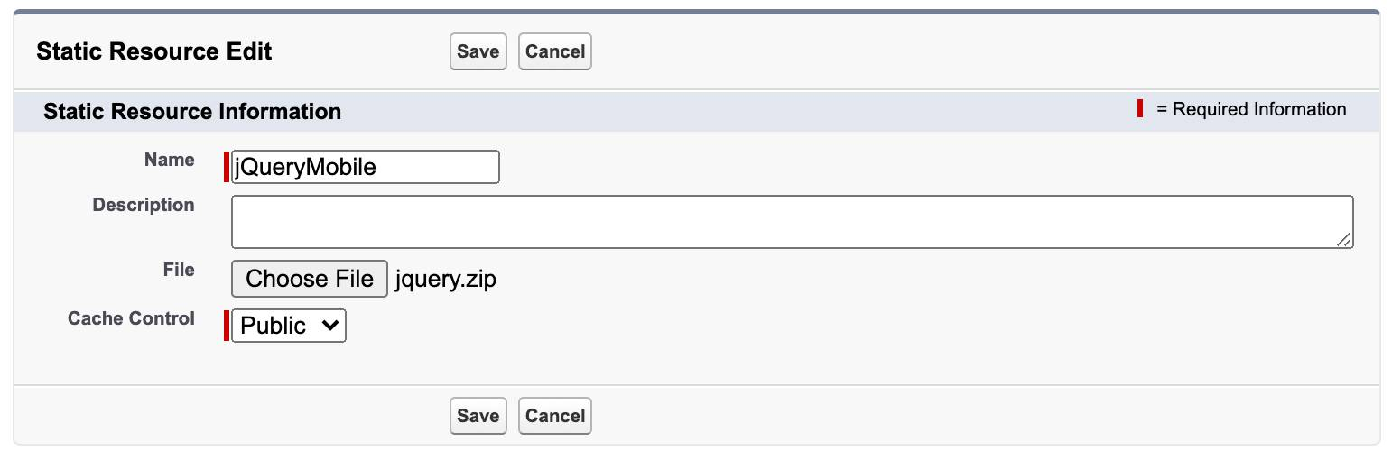
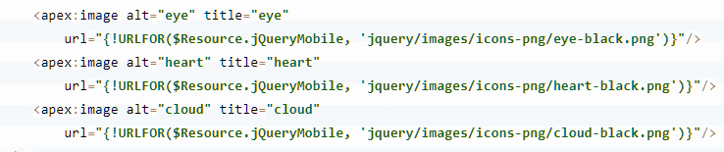
Visualforce Basics Add Zipped Static Resources

Slide 40
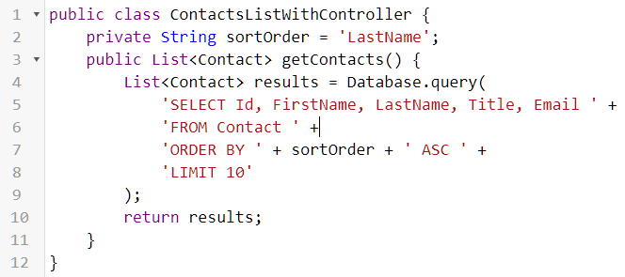
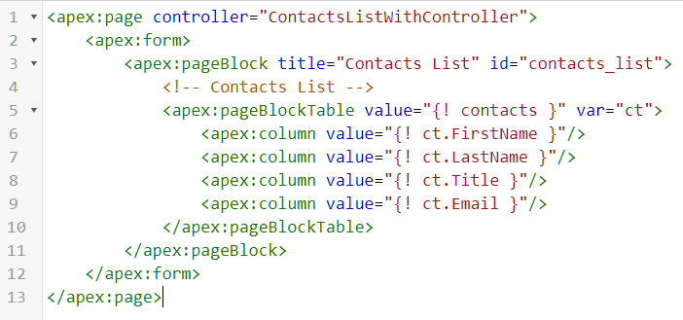
Visualforce Basics Create & Use Custom Controllers
Custom controllers contain custom logic and data manipulation that can be used by a Visualforce page.

Slide 41

THANKS!
Do you have any questions?

